Slide 1
The Emergence of the Modern Middle East
Activities Unlimited, March 7, 2023
Tom Butler

Slide 2
Differing World Views
France and Britain: The Imperial Vision
“world order” “economic prosperity“ “benign administration”
Ottoman Lands: Nationalist Vision
“Independence” “National Identity” “Autonomy/Self-rule”
Young Turk Revolution (1908)- Committee of Union and Progress (C.U.P.);
Persian Constitutional Revolution” (1905-1911)
Al-Fatat Movement (Young Arab Society) 1909

Slide 3
Ottoman Lands in 1914

Slide 4
Sharif Hussein bin Ali

Slide 5
Role of Hussein (1853-1931)
Tribal leader of Hashem clan
Three sons: Ali; Abdullah; and Faisal
Distrusted by Ottomans and summoned to Istanbul 1893
C.U.P. appoints him Sharif of Mecca 1908
Enjoyed considerable independence provided taxes collected and paid to Istanbul
Grandiose goal was to be “king of Arabs” and Caliph
Increasingly distant from Ottomans who sought to replace him with a rival tribal leader 1914-1915.
Contacts with the British start in 1914

Slide 6
Abdullah bin al-Hussein

Slide 7
Kitchener Meeting
Kitchener meets with Abdullah bin al Hussein (Feb 5, 1914)
Meeting in Cairo prompted by “secret Ottoman discussions” about replacing Sharif Hussein’s leadership with someone from a rival clan
Sought British assurance of support against “wanton Turkish aggression” (Kitchener supportive, but no reply due to “great power” concerns until after outbreak of WWI)
Nonetheless, Kitchener’s Oriental Secretary, Sir Ronald Storrs, met with Abdullah in April and provided assurances that Britain would support the Sharif in case of aggression.
Ottoman declaration of war (Oct 31, 1914) and jihad fatwa on Nov 11, 1914
British more seriously consider Hussein’s potential support.

Slide 8
Faisal bin Al-Hussein bin Ali Al-Hashemi

Slide 9
Background to Damascus Letters
Hussein instructs son, Faisal, to contact al-Fatat while passing through Damascus on way to Istanbul to prevent any plans to replace father
Al-Fatat asks Faisal to support their plan, but remains unconvinced.
Returning from Istanbul, Faisal re-visits Damascus, becomes a member of al-Fatat and is committed to “Arab independence”
Faisel delivers Al Fatat letters to Hussein May 23, 1915
Ultimately its platform adopted by Hussein and broadly defined his understanding of the term “Arab lands”

Slide 10
The Damascus Protocol
"The recognition by Great Britain of the independence of the Arab countries lying within the following frontiers:
North: The Line Mersin-Adana to parallel 37N. and thence along the line Birejek-Urga-Mardin-Midiat-Jazirat (Ibn 'Unear)-Amadia to the Persian frontier; East: The Persian frontier down to the Persian Gulf; South: The Indian Ocean (with the exclusion of Aden, whose status was to be maintained). West: The Red Sea and the Mediterranean Sea back to Mersin. The abolition of all exceptional privileges granted to foreigners under the capitulations. The conclusion of a defensive alliance between Great Britain and the future independent Arab State.
The grant of economic preference to Great Britain."

Slide 11
McMahon- Hussein Letters
Fifteen letters exchanged between July 1915 and March 1916
British objective: to counteract Ottoman call for jihad (India!)
Hussein objective: Arab independence under him
Subsequent controversy about what was promised by the British
Independence “in the limits and boundaries proposed by the Sherif of Mecca…(excepting) portions of Syria (lying west of) districts of Damascus, Homs, Hama and Aleppo.”
McMahon encouraged Hussein to believe he would rule a vast Arab empire

Slide 12
Anglo French Talks on Dividing Up Ottoman Lands
From November 1915 to March 1916, representatives of Britain and France negotiated an agreement, with Russia offering no objection. The secret agreement, known as the Sykes–Picot Agreement, was named after its lead negotiators, the aristocrats Sir Mark Sykes of England and François Georges-Picot of France.
Its terms were set out in a letter from British Foreign Secretary Sir Edward Grey to Paul Cambon, France’s Ambassador to Great Britain, on May 16, 1916.
Essentially anticipated French control over Syria and Lebanon and English control over Iraq and Trans-Jordan and Palestine

Slide 13
Major Sections of the Sykes-Picot Agreement
Prepared to recognize independent Arab states or confederation of states
In area a France and in b Britain shall have priority of right to enterprise and loans
In blue area , France and in red area, Britain may establish such direct or indirect control as they may think fit to arrange with the Arab states
Great Britain will be accorded ports of Haifa and Acre
Haifa will be a free port as regards the trade of France
For 20 years the existing Turkish customs tariffs shall remain in force and there shall be no interior customs borders
The negotiations with the Arabs as to boundaries shall be continued through the same channels as heretofore on behalf of the two powers

Slide 14
Map of Sykes-Picot Agreement

Slide 15
The Arab Revolt June 1916-Oct 1918
Arab nationalists in Damascus arrested/executed early 1916
Hussein feared he might be next. Rallied local tribes and initiated attack on Ottoman garrison at Mecca. Declared himself “King of the Arab Lands”
Successes largely relied on British and Egyptian forces (artillery) and British and French naval forces controlling the Red Sea.
Russian Revolution November 1917 and release of Sykes-Picot terms
Hussein discussed changing sides with Ottoman officials. Lawrence intervened and smoothed things out.
British came to view King’s sons, Faisal and Abdullah, as more reliable partners.

Slide 16
Faisal at Paris Peace Conference (T.E. Lawrence on his left in keffiyeh)

Slide 17
Paris Peace Conference (1919) Treaty of Sevres (signed Aug 10, 1919 Treaty of Lausanne (signed July 24, 1923)
Treaty formalized division of Ottoman territory, as anticipated by the Sykes-Picot Agreement. Established Mandate system.
France awarded Mandate Syria; British awarded Mandate Iraq (agreed at San Remo Conference, April, 1919, along with Mosul oil concession)
Hussein recognized as King of the Hejaz
Furious reaction in Turkey, Ottoman negotiators dismissed by National Assembly and Treaty rejected. (Hussein also refused to sign off on Treaty)
Period of Turkish wars with Greeks (had been awarded territory around Izmir), French (over Constantinople) and British (supporting Greeks and over the Straits). Armistice of Mudanya Oct. 1921. Treaty of Lausanne Aug 1923 (Independence of Turkey recognized; Sevres nullified; Mandates and most territorial changes remain in place)

Slide 18
Treaty of Lausanne 1923 Mandates

Slide 19
Hussein bin Ali’s Fate
Deeply effected by Sykes-Picot and Balfour Declaration
Unwilling to approve Treaty of Sevres
British considered him inflexible and uncooperative when he refused to sign the Anglo-Hashemite Treaty (1922) and as a result British withdrew support when ibn Saud invaded to Hejaz.
October 1924, abdicated in face of ibn Saud-Wahhabi assault on Mecca in favor of son Ali
December, 1924 Ali surrendered to Saudi Wahhabi army, ending the Kingdom of Hejaz and the Sharifate of Mecca
Ibn Saud becomes King of Hejaz and Majd (renamed Saudi Arabia in 1932)

Slide 20
Faisal”s Fate
Before Sevres signed, nationalist uprising in Syria.
Syrian National Congress names Faisal “King of Arab Kingdom of Syria” (March 1919)
San Remo Conference (April, 1919) awards Mandate to France
French forces defeat nationalists and Faisal expelled from Syria
March, 1921, Cairo Conference (advised by T.E. Lawrence) settled on Faisal to be ruler of Iraq. British organized a plebiscite to legitimate Faisal’s becoming King of Iraq (23 August 1921)
A “modern” monarch, focused on education, public health and modernization… but he ignored the Shia majority’s feelings.
British-Iraqi Treaty 1930 provided increased independence and led to full independence in 1932 (joined League of Nations)
Died 1933, succeeded by son Ghazi. Grandson, Faisal II overthrown 1958

Slide 21
Abdullah’s Fate
Remained a strong ally of the British during the Arab Revolt
July, 1919 moved his army from Hejaz to TransJordan with intention of trying to liberate Damascus after French defeated Faisal. Established an emirate of TransJordan
Met with Churchill in Cairo in 1921 and was persuaded not to intervene in Syria. Continued as Emir
1946 Mandate ended and Hashemite Kingdom of TransJordan (renamed Jordan in 1948) proclaimed. (current King is Abdullah II)
1951 Abdullah assassinated in Jerusalem

Slide 22
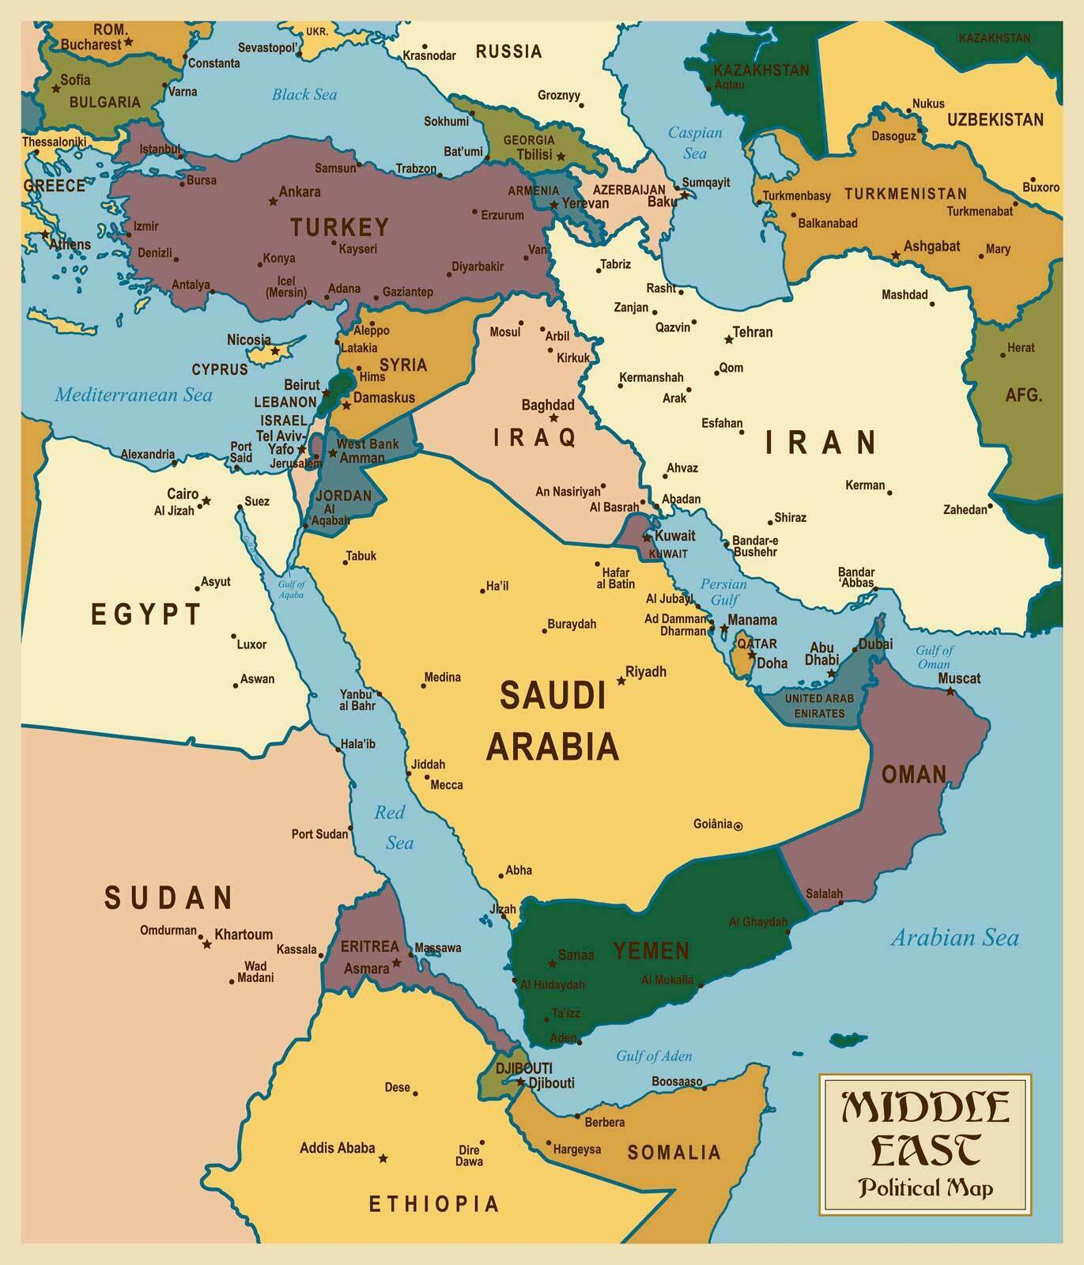
The Modern Middle East

